Slide 1
Entrepreneurial Orientation in Building the Knowledge-Based Resources of the Enterprises Assoc. prof. Małgorzata Okręglicka, PhD.

Slide 2
Introduction
Two organizational constructs were analysed in my study: entrepreneurial orientation (EO) and knowledge-based resources (KBR)
First construct - EO is an organizational attribute that connects entrepreneurial behaviour with firms’ strategic decision-making styles, methods, and practices. An EO construct consists of: risk taking, innovation, proactivity, autonomy, and competitive aggressiveness.
Second construct is KBRs. Knowledge is not a resource accumulated only in the minds of individuals, but is embedded in procedures, processes, structures and in social relationships created with stakeholders.
The question is if the need for entrepreneurship will force a change in KBR.

Slide 3
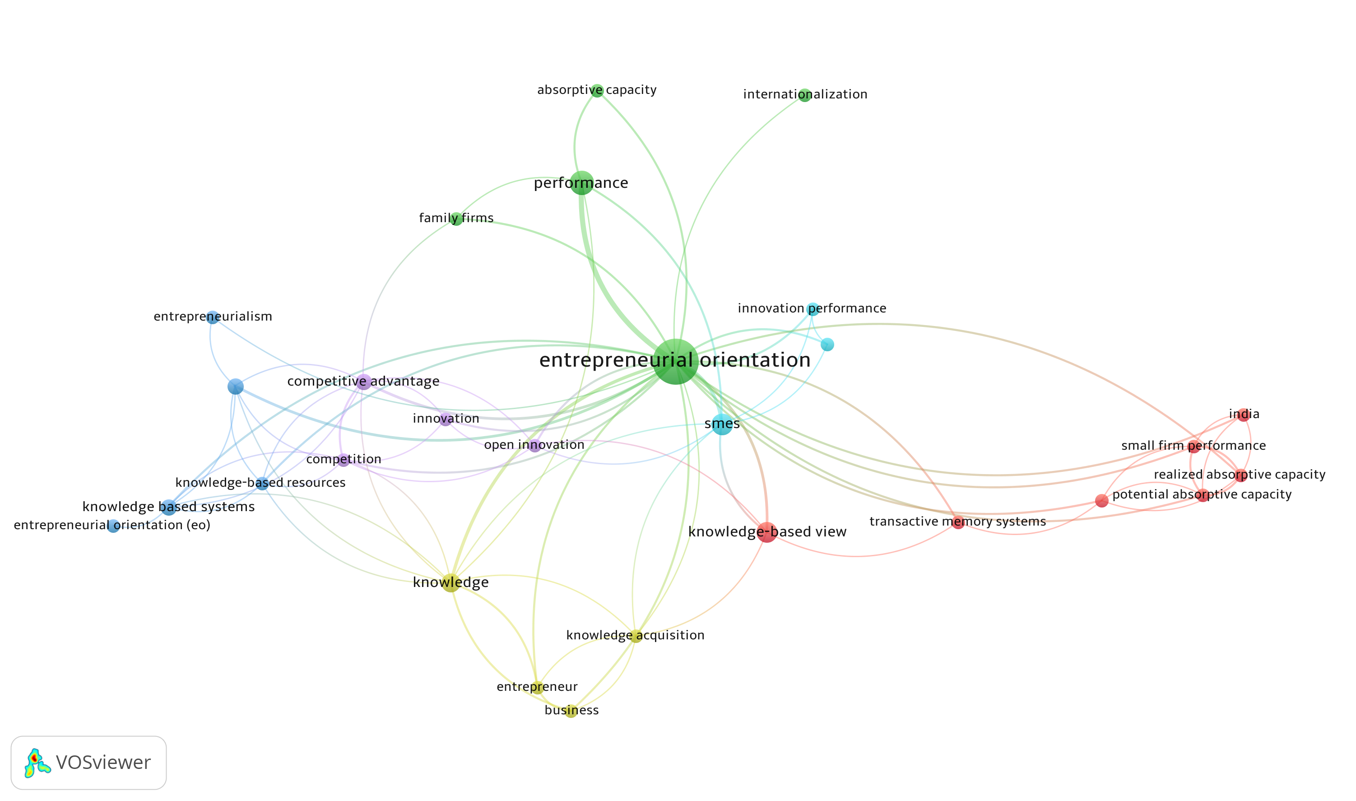
Network visualization

Slide 4
Main aim and hypothesis
The main aim is to study the impact of the level of EO on the level of KBR embedded in the organization.
In the course of research process, the hypothesis was proposed:
Hypothesis 1. Firms that are more entrepreneurially orientated create higher level of knowledge-based resources

Slide 5
Methods
The research was conducted in early 2022 in form of the questionnaire survey.
A questionnaire was prepared based on an in-depth review of the literature.
A questionnaire consisted of two groups of questions, which diagnosed:
the level of entrepreneurial orientation (EO): organizational autonomy; proactivity; innovation; competitive aggressiveness; risk taking
the level of knowledge-based resources (KBR): it consists of nine sub-variables and the final KBR variable is the mean of the sub-variables.

Slide 6
Methods
A direct method of data collection was used.
The final research sample covers 355 Polish enterprises:
42.5% - micro-enterprises;
25.4% - small enterprises;
14.3% - medium-sized enterprises;
17.8% - large enterprises,
The selection of the research group was random and convenient.
The managerial approach was adopted.

Slide 7
Methods
The 5-point Likert scale was used for assessments of the respondents
The reliability and validity of the research was investigated using Cronbach’s α coefficient, average variance extracted (AVE) and composite reliability (CR).
The multiple regression model was built to find the link between the independent variable (EO) and the dependent variable (KBR).

Slide 8
Results
Table 1: Reliability and validity
Variable | Factor loading | Cronbach’s α | CR | AVE
Knowledge-based resources |  | 0.91 | 0.91 | 0.52
KBR1 | 0.668
KBR2 | 0.731
KBR3 | 0.795
KBR4 | 0.758
KBR5 | 0.783
KBR6 | 0.679
KBR7 | 0.741
KBR8 | 0.574
KBR9 | 0.733
Entrepreneurial orientation |  | 0.78 | 0.83 | 0.50
EO1 | 0.650
EO2 | 0.666
EO3 | 0.787
EO4 | 0.709
EO5 | 0.717

Slide 9
Results
Table 2: Descriptive statistics and correlation analysis (n=355; p<0.001)
 | Mean | S.D. | KBR | EO1 | EO2 | EO3 | EO4 | EO5
Knowledge-based resources (KBR) | 3.45 | 0.69 | 1.00
EO1 (autonomy) | 3.95 | 0.98 | 0.29 | 1.00
EO2 (proactivity) | 4.05 | 0.96 | 0.33 | 0.37 | 1.00
EO3 (innovativeness) | 3.91 | 1.02 | 0.37 | 0.44 | 0.46 | 1.00
EO4 (competitive aggressiveness ) | 3.59 | 1.28 | 0.35 | 0.28 | 0.28 | 0.43 | 1.00
EO5 (risk taking) | 3.52 | 1.26 | 0.32 | 0.31 | 0.31 | 0.35 | 0.45 | 1.00

Slide 10
Results
Table 3: Multiple regression model summary
R Square | Adjusted R Square | Sum of Squares SS | df | Mean Square MS | Change Statistics |  |  | F | p
 |  |  |  |  | SS | df | MS
0.342 | 0.332 | 57.65 | 5 | 11.53 | 111.12 | 349 | 0.318 | 36.21 | 0.00
n=355 | Parameters estimates Sigma-restricted parameterization
 | KBR Param. | KBR Std. Err. | t | p
Intercept | 1.555 | 0.156 | 9.963 | 0.000
EO1 (autonomy) | 0.095 | 0.036 | 2.615 | 0.009
EO2 (proactivity) | 0.094 | 0.038 | 2.443 | 0.015
EO3 (innovativeness) | 0.111 | 0.040 | 2.748 | 0.006
EO4 (competitive aggressiveness ) | 0.119 | 0.029 | 4.076 | 0.000
EO5 (risk taking) | 0.080 | 0.029 | 2.762 | 0.006

Slide 11
Conclusion
Summarizing the research results, the two-way relationship between EO and KBR should be emphasized. Both analysed variables ​​stimulate each other, which ultimately stimulates business performance.
Enterprises should therefore strategically stimulate corporate entrepreneurship, shaping entrepreneurial attitudes and behaviour of all members of the organization, and strive to create, implement and constantly strengthen the organization's KBR.
It can be assumed that the presented results are also important for the practice of entrepreneurship. Managers should also be inclined to treat the analysed quantities as dynamic capabilities that require ongoing adjustments and a strategic management perspective.

Slide 12
Thank you for your attention

